Slide 1
UML Diagrams

Slide 2
What is UML?
Standard language for specifying, visualizing, constructing, and documenting the artifacts of software systems, business modeling and other non-software systems.
The UML represents a collection of best engineering practices that have proven successful in the modeling of large and complex systems.
The UML is a very important part of developing object oriented software and the software development process.
The UML uses mostly graphical notations to express the design of software projects.
Using the UML helps project teams communicate, explore potential designs, and validate the architectural design of the software.

Slide 3

Overview of UML Diagrams
Behavioral
: behavioral features of a system / business process
Activity
State machine
Use case
Interaction
Structural
: element of spec. irrespective of time
Class
Component
Deployment
Object
Composite structure
Package
Interaction
: emphasize object interaction
Communication(collaberation)
Sequence
Interaction overview
Timing

Slide 4
Class diagram
UML class diagrams show the classes of the system, their inter-relationships, and the operations and attributes of the classes
Explore domain concepts in the form of a domain model
Analyze requirements in the form of a conceptual/analysis model
Depict the detailed design of object-oriented or object-based software

Slide 5
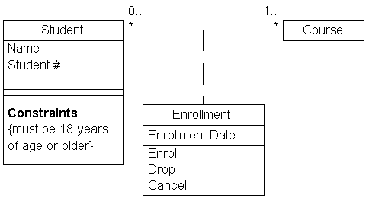
Class diagram

Slide 6
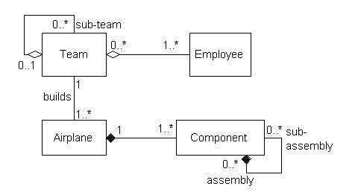
Class diagram

Slide 7
Component diagram
UML component diagrams shows the dependencies among software components, including the classifiers that specify them (for example implementation classes) and the artifacts that implement them; such as source code files, binary code files, executable files, scripts and tables.

Slide 8
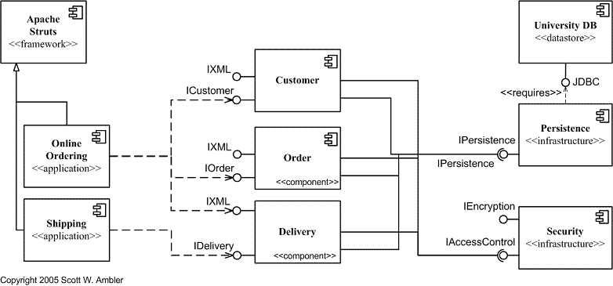
Component diagram

Slide 9
Deployment diagram
UML deployment diagram depicts a static view of the run-time configuration of hardware nodes and the software components that run on those nodes. Deployment diagrams show the hardware for your system, the software that is installed on that hardware, and the middleware used to connect the disparate machines to one another.

Slide 10
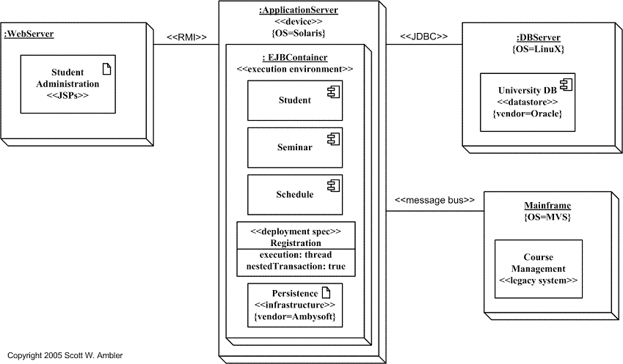
Deployment diagram

Slide 11
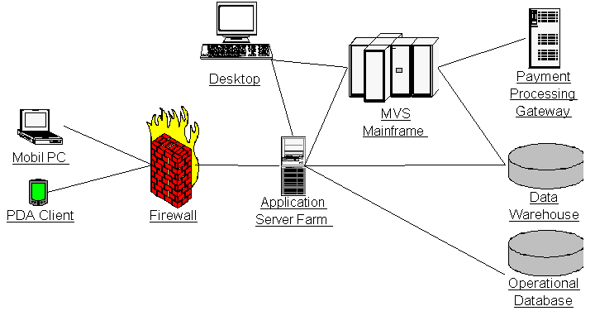
Deployment diagram

Slide 12
Object diagram
UML 2 Object diagrams (instance diagrams), are useful for exploring real world examples of objects and the relationships between them. It shows instances instead of classes. They are useful for explaining small pieces with complicated relationships, especially recursive relationships.

Slide 13
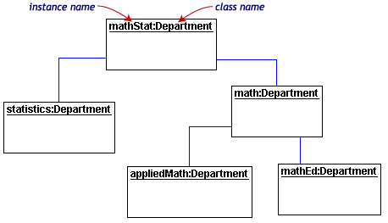
Object diagram

Slide 14
Package diagram
UML 2 Package diagrams simplify complex class diagrams, it can group classes into packages. A package is a collection of logically related UML elements. Packages are depicted as file folders and can be used on any of the UML diagrams.

Slide 15
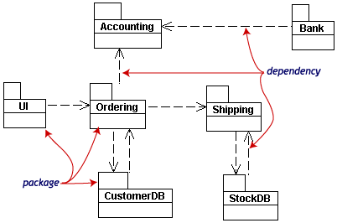
Package diagram

Slide 16
Composite structure diagram
UML 2 Composite structure diagrams used to explore run-time instances of interconnected instances collaborating over communications links. It shows the internal structure (including parts and connectors) of a structured classifier or collaboration.

Slide 17
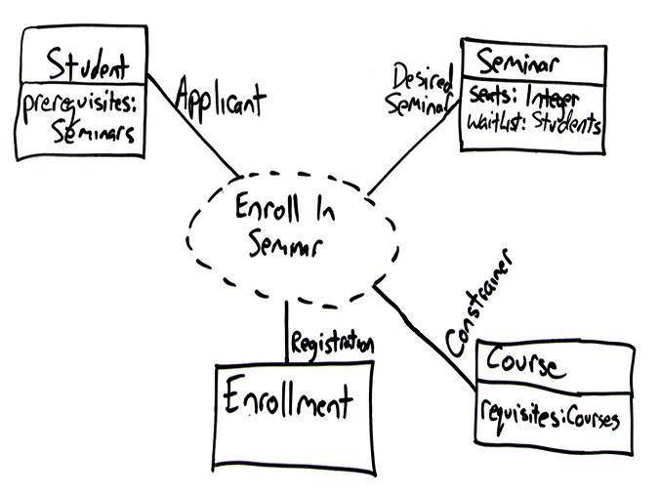
Composite structure diagram
Notes:
Dashed oval : collaboration , rectangular : instances of any type of classifier, including classes, objects, or interfaces

Slide 18
Activity diagram
UML 2 Activity diagrams helps to describe the flow of control of the target system, such as the exploring complex business rules and operations, describing the use case also the business process. It is object-oriented equivalent of flow charts and data-flow diagrams (DFDs).

Slide 19
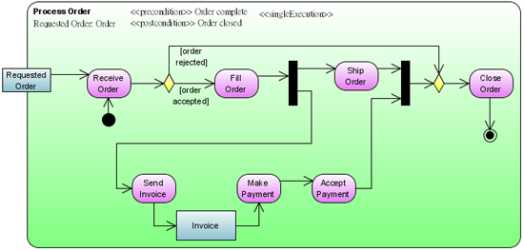
Activity diagram
Notes:
Dashed oval : collaboration , rectangular : instances of any type of classifier, including classes, objects, or interfaces

Slide 20
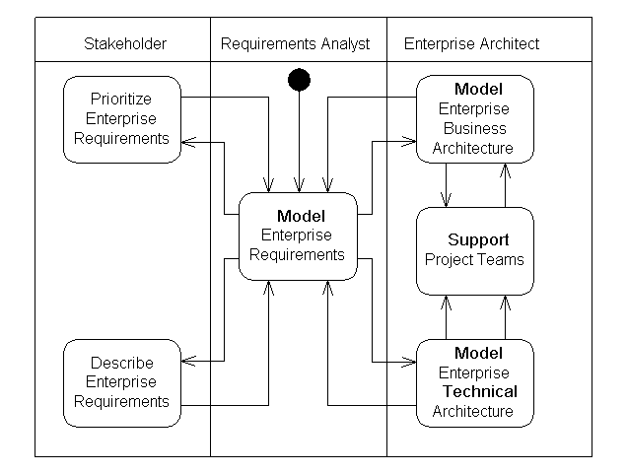
Activity diagram
Notes:
A swimlane is a way to group activities performed by the same actor on an activity diagram or to group activities in a single thread.

Slide 21
State machine diagram
UML 2 State machine diagrams can show the different states of an entity also how an entity responds to various events by changing from one state to another. The history of an entity can best be modeled by a finite state diagram.

Slide 22
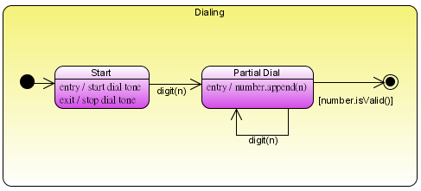
State machine diagram
Notes:
Dashed oval : collaboration , rectangular : instances of any type of classifier, including classes, objects, or interfaces

Slide 23
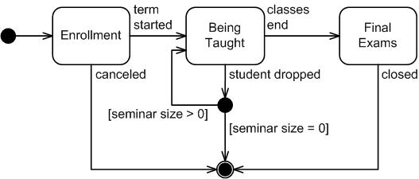
State machine diagram

Slide 24
Use cases diagram
UML 2 Use cases diagrams describes the behavior of the target system from an external point of view. Use cases describe "the meat" of the actual requirements.
Use cases. A use case describes a sequence of actions that provide something of measurable value to an actor and is drawn as a horizontal ellipse.
Actors. An actor is a person, organization, or external system that plays a role in one or more interactions with your system. Actors are drawn as stick figures.
Associations. Associations between actors and use cases are indicated by solid lines. An association exists whenever an actor is involved with an interaction described by a use case.

Slide 25

Use cases diagram

Slide 26
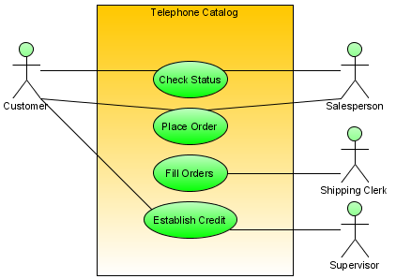
Use cases diagram
Notes:
Dashed oval : collaboration , rectangular : instances of any type of classifier, including classes, objects, or interfaces

Slide 27
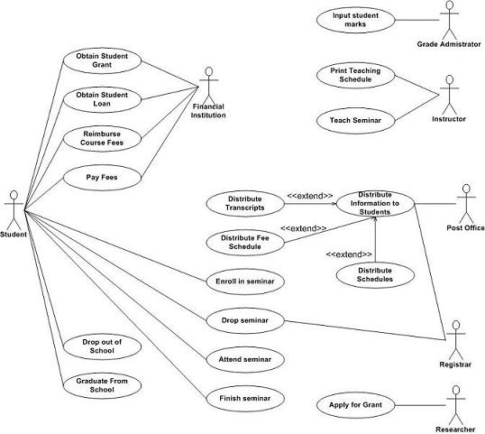
Use cases diagram

Slide 28
Communication diagram
UML 2 Communication diagrams used to model the dynamic behavior of the use case. When compare to Sequence Diagram, the Communication Diagram is more focused on showing the collaboration of objects rather than the time sequence.

Slide 29
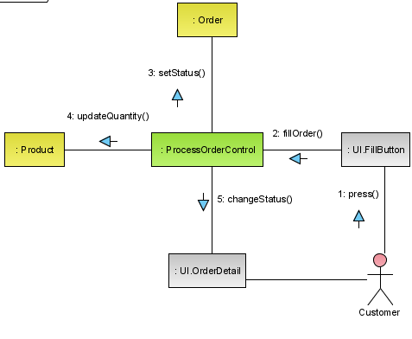
Communication diagram
Notes:
Dashed oval : collaboration , rectangular : instances of any type of classifier, including classes, objects, or interfaces

Slide 30
Sequence diagram
UML 2 Sequence diagrams models the collaboration of objects based on a time sequence. It shows how the objects interact with others in a particular scenario of a use case.

Slide 31
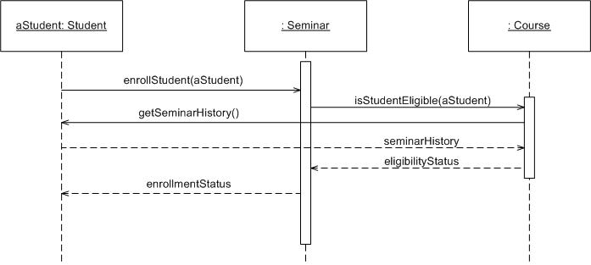
Sequence diagram
Notes:
Dashed oval : collaboration , rectangular : instances of any type of classifier, including classes, objects, or interfaces

Slide 32
Timing diagram
UML 2 Timing diagrams shows the behavior of the objects in a given period of time. Timing diagram is a special form of a sequence diagram. The differences between timing diagram and sequence diagram are the axes are reversed so that the time are increase from left to right and the lifelines are shown in separate compartments arranged vertically.

Slide 33
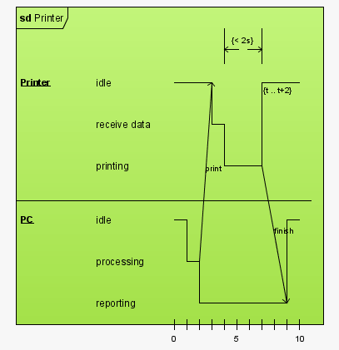
Timing diagram
Notes:
Dashed oval : collaboration , rectangular : instances of any type of classifier, including classes, objects, or interfaces

Slide 34
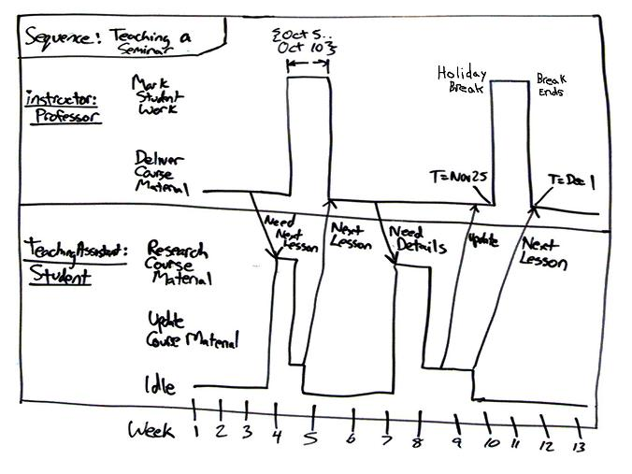
Timing diagram

Slide 35
Interaction overview diagram
UML 2 Interaction overview diagrams focuses on the overview of the flow of control of the interactions. It is a variant of the Activity Diagram where the nodes are the interactions or interaction occurrences. It describes the interactions where messages and lifelines are hidden.

Slide 36
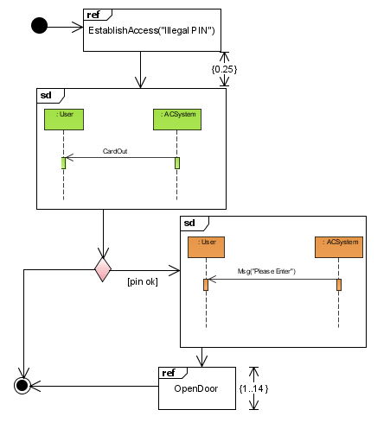
Interaction overview diagram
Notes:
Dashed oval : collaboration , rectangular : instances of any type of classifier, including classes, objects, or interfaces

Slide 37
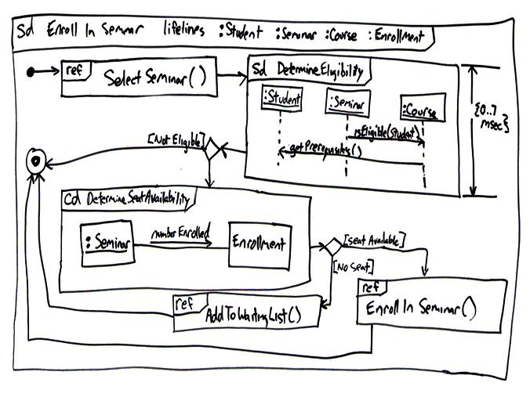
Interaction overview diagram

Slide 38
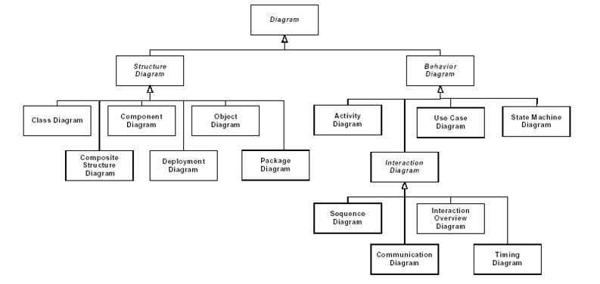
UML diagram hierarchy

